Slide 1
Chapter Four
Beatus vir suffert tentationem,… enim coronam vitae recipiet.

Slide 2
Contents
Tenses of Infinitives
Present Active Present Stem + re
Perfect Active Perfect Stem + isse
Future Active Participial Stem + ur + -us, -a, -um endings and esse
Present Passive Present Stem + ri (except for 3rd conjugation)
Perfect Passive Participial Stem + endings, -us, -a, -um + esse

Slide 3
Infinitives
videre – to see
videri – to be seen
vidisse – to have seen
visurus esse – to be about to see
visus esse – to have been seen
videri – to be seen

Slide 4
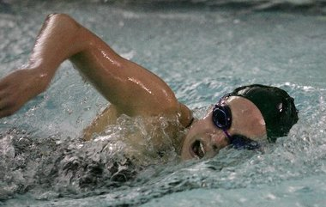
Subject Infinitives
Natare celeriter est meum consilium.
To swim fast is my plan. Swimming fast is my plan.

Slide 5
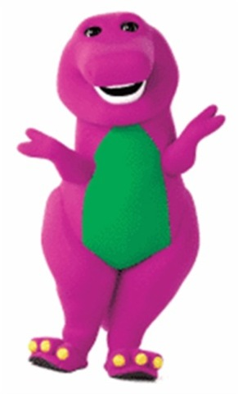
Reflexive Pronouns
Reflexive Pronouns refer back to the subject.
I love myself. Amo me. You love yourself. Amas te. He loves himself. Amat se.

Slide 6
Decline reflexive pronouns.
Reflexive Pronouns are the same in the singular and plural.
Nominative. (none) Genitive. sui Dative. sibi Accusative. se (or sese) Ablative. se (or sese)

Slide 7
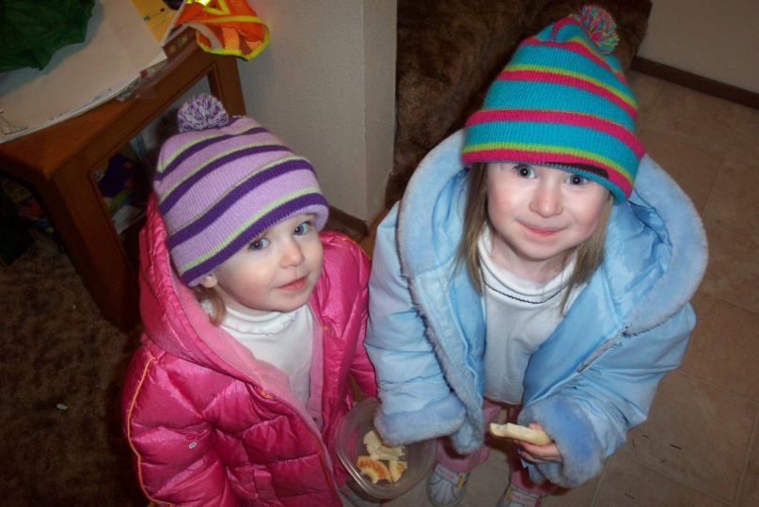
Direct Quotation
She said, “I like my sister.” Ea dixit, “Meam sororem amo.”

Slide 8
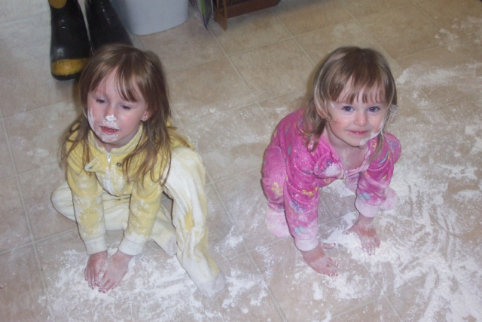
Indirect Quotation
Indirect Quotation
She said that she likes her sister. Change to: She said her to like her sister.
Ea dixit eam amare suam sororem.

Slide 9
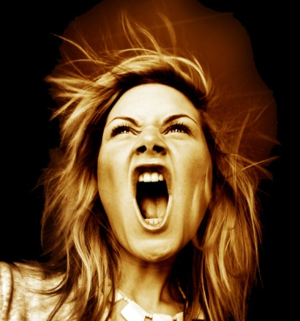
Main Verb present.
When the main verb is in the present tense,
Dicit eam clamare. He says she is shouting.
Dicit eam clamavisse. He says she has shouted.
Dicit eam clamaturam esse. He says she is about to shout.

Slide 10
Main Verb perfect.
When the main verb is in the perfect tense,
Dixit eam clamare. He said she was shouting.
Dixit eam clamavisse. He said she had shouted.
Dixit eam clamaturam esse. He said she would (or, will) shout.

Slide 11
Main Verb future.
When the main verb is in the future tense,
Dicet eam clamare. He shall say she is shouting.
Dicet eam clamavisse. He shall say she has shouted.
Dicet eam clamaturam esse. He shall say she will shout.

Slide 12
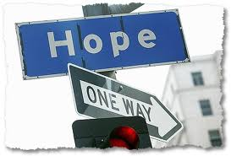
Vocabulary
stultus miraculum
statim sui
undique spero
finis vito

Slide 13
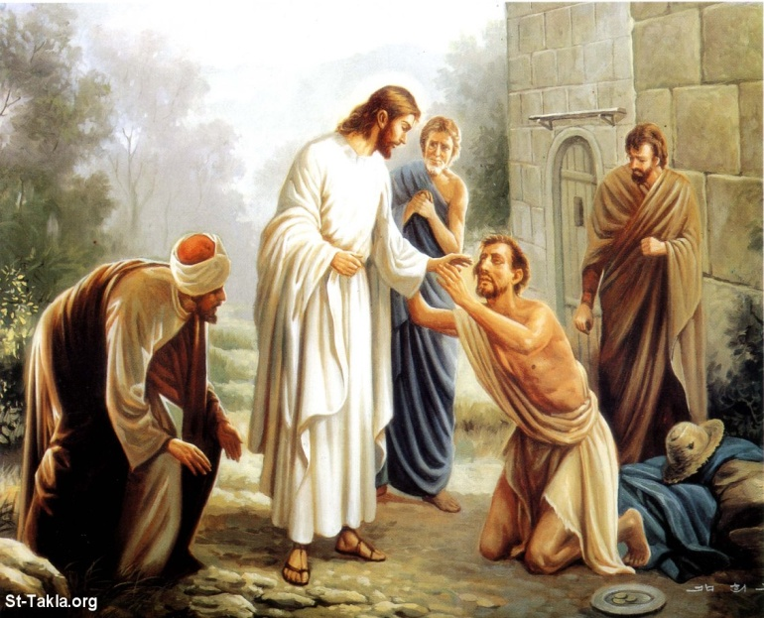
Vocabulary
dimitto
reddo
miraculum

Slide 14
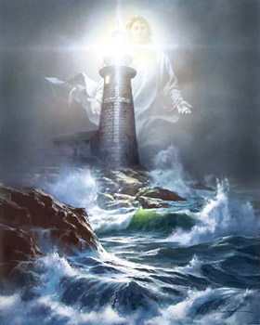
Exercise A.
Dominus lux mea est.
The Lord is my light.

Slide 15
Exercise B.
1. Potest dimittere. He is able to forgive. He can forgive.
Potest adiuvare. He is able to help. He can help.
Potest invenire. He is about to find. He can find.

Slide 16
Exercise C.
nom.s. pres.pass.3/s. perfect active infinitive
Who is said to have rejoiced?
Quis dicitur exsultavisse?
OR: Quis exsultavisse dicitur?

Slide 17
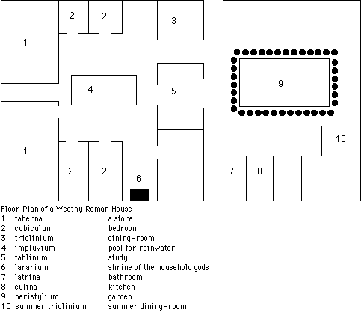
A Roman Home

Slide 18
Veniens Per Tectum
Reading Lesson
Veniens ex Suo itinere a longissimis finibus Galileae, Iesus in Capharnao iterum erat. Et Chuza sollicitus erat. Is nonnullas et molestas res a Iairo audiverat. Propter miracula quae Iesus in Capharnao et circum Capharnaum fecerat et doctrinas quas docebat, quidam scribae et Pharisaei ad Capharnaum venerant. Erant curiosi. Putaverunt Iesum esse blasphemum, et Eum diligenter spectare voluerunt.
Consilium Chuzae erat videre Iesum, et narrare Ei omnia quae audiverat. Sed ubi ad villam appropinquabat ubi Iesus manebat, villam esse plenam hominum vidit.

Slide 19
Reading Lesson
Peristylium quoque erat plenum. Homines villam circumdederunt quoniam Iesum dicentem audire vel Eum videre sperabant. Homines undique venerant quod Eum audire volebant. Scribae et Pharisaei, quos Chuza
timebat, iam ibi erant, audientes et spectantes.
Quoniam Chuza erat magistratus pro Herode Antipate, per turbam venire poterat. Mox ad Iesum venit.
Quattuor homines portantes onus inusitatum ad villam venerunt.

Slide 20
Reading Lesson
Lectum portabant. Aegrotus, qui movere non poterat, in lecto incubabat. Quoniam per turbam eum portare non poterant, tectum villae ubi Iesus sedebat et dicebat amovebant. Lectum, in quo paralyticus incubabat, sub tectum ponebant.
Iesus, videns eorum fidem, homini dixit, "Mi fili, tua peccata dimittuntur." Erant autem nonnulli scribae sedentes et cogitantes in animis suis, "Cur ita dicit? Blasphemat. Quis potest dimittere peccata, nisi solus Deus?"

Slide 21
Reading Lesson
Statim Iesus, cogitans eorum sententias, et eos dicere intra se, dixit illis, "Cur putatis mala in vestris animis? Quid est facilius dicere paralytico, ′Dimittuntur tua peccata,′ vel dicere, ′Surge, tolle lectum tuum, et ambula′?"
"Filius Hominis potestatem habet in caelo etiam in terrā dimittendorum peccatorum. Itaque dico, ′Surge, tolle tuum lectum, et ambula.′"
Et paralyticus surrexit et ad suam villam ambulavit.

Slide 22
Reading Lesson
Jesus healed the paralytic.

