Slide 1
Chapter Eighteen
Nolite esse cum infidelibus. Quae enim participation iustitiae cum iniquitate?

Slide 2
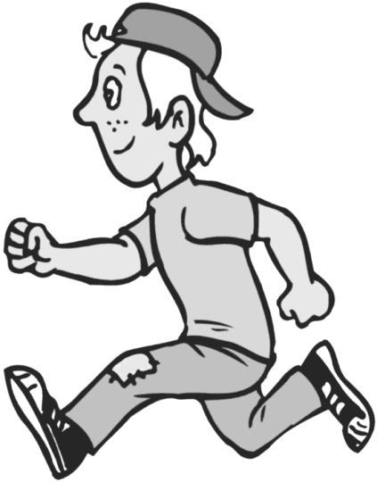
A Gerund
A gerund is a noun made from a verb.
In English, it is a verb which has added –ing to it, making it a noun.
I like running.
He is tired of running. Running is fun.

Slide 3
A Gerund.
Use the present stem + nd + neuter endings.
ama + nd + case endings.
Only four cases. Use the infinitive for nominative case.
amare

Slide 4
Decline a gerund.
Nom. amare
Gen. amandi
Dat. amando
Acc. amandum
Abl. amando
Now, YOU do one.
Nom.
Gen.
Dat.
Acc. Abl.

Slide 5
What is a gerundive?
A gerundive is similar to a gerund, but it is an adjective.
Its endings agree with the noun it modifies.
It can be singular or plural, depending on its noun.

Slide 6
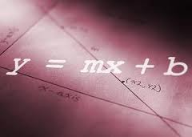
Examples of gerundives.
Nominative: Ludere pedifollem est bonum.
Genitive: Puella est defessa ludendi pedifollem.
Dative: Dat tempus spectando puellis.
He gives his time to watching girls.
Accusative: Ludere amo.
I like to play… I like playing.
Ablative: Didici docendā algebrā. I learned by teaching algebra.

Slide 7
Purpose Clauses
Subjunctive with ut or ne
Studet ut arithmeticam discerent.
Subjunctive with relative pronoun
Studebat qui disceret arithmeticam.
Gerund or gerundive with ad
Studet ad discendam arithmeticam.
Gerund or gerundive with causa
Studet discendae arithmeticae causa.

Slide 8
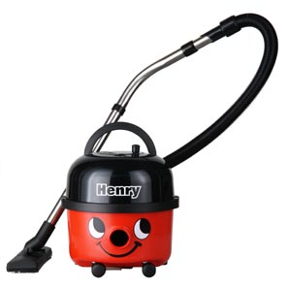
Vocabulary
bellus graviter confudo
carus lente contineo
familiaris brachium flecto
terribilis facies praecedo
vacuus sectator tremo

Slide 9
Exercise A.
Ad confudendum
Purpose Clause
to confuse………….
Literally, for the purpose of confusing

Slide 10
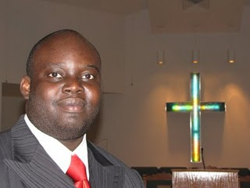
Exercise B.
by leading his followers…
Gerund or gerundive?
There is an object, so gerundive.
What case? “by” indicates ablative.
ducendis suis sectatoribus (or eius…)

Slide 11
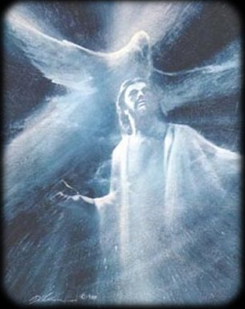
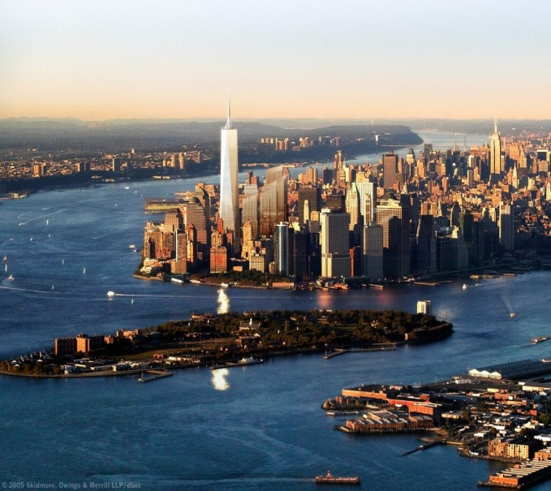
Exercise C.
1. Ubi Spiritus Domini est, est libertas.
Why are there two “ests?”

Slide 12
Exercise D.
“Iter fecimus longe et late ad inveniendum bellissimum montem.”
Is there a purpose clause in this sentence?
Main clause: Iter fecimus longe et late …
What kind of clause is this one?
…ad inveniendum bellissimum montem.”

Slide 13
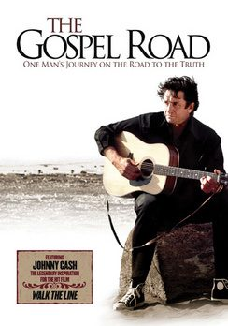
The Gospel Road

Slide 14
The Gospel Road
1. Sic enim Deus dilexit mundum, ut Filium suum unigenitum daret, ut omnis qui credit in Eum, non pereat, sed habeat vitam aeternam.
2. Omnes enim peccaverunt, et egent gloriam Dei.
3. Stipendia enim peccati mors.
4. Crede in Dominum Iesum, et salvus eris tu, et domus tua.
5. Estote (be) autem factores Verbi, et non auditores tantum, fallentes vosmet ipsos (your own).
Quia si quis auditor est Verbi et non factor, hic conparabitur viro consideranti vultum nativitatis suae in speculo.
.

Slide 15
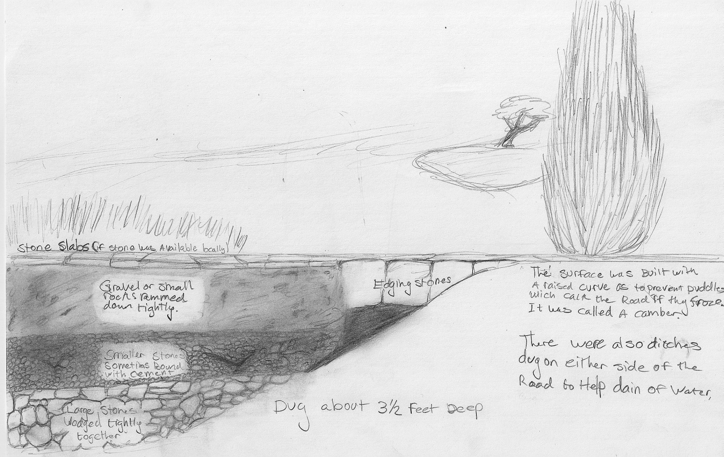
Roman Roads
Original drawing by student Mary Joy Johnson.

Slide 16
Roman Roads
What was the design?
What was laid down first?
What was the middle layer?
How were the sides of the roadways marked?
What was on the top layer of the road?
How did they cross hills and mountains?
Draw or construct a roadway like the Romans did.

Slide 17
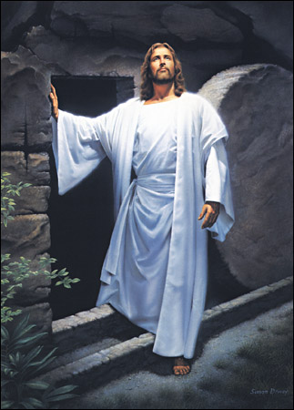
Argument for the Resurrection
Why is this important?
Give at least three historical evidences.
Decide what is true.

Slide 18
He is not Here!
Section A.
Mane primā die e hebdomade, feminae ad sepulchrum profectae sunt. Erant Maria Magdalena et Maria Cleophae et Salome Zebedaei et Ioanna Chuzae et Aquila Fideli. Cum ad hortum Ioseph appropinquarent, canum primae lucis trans caelum videre poterant.
Graviter ambulabant; capita earum flexa sunt. Dum propius et propius ambulabant, fiebant miseriores et miseriores.

Slide 19
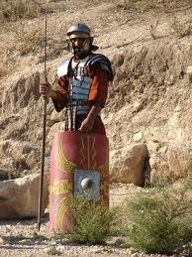
He is not Here!
Tum inquit Maria Cleophae, “Quis saxum ab ianuā sepulchri pro nobis amovebit?”
Aquila respondit, “De hoc non putabamus!” Observabant autem tunc saxum iam motum esse.

Slide 20
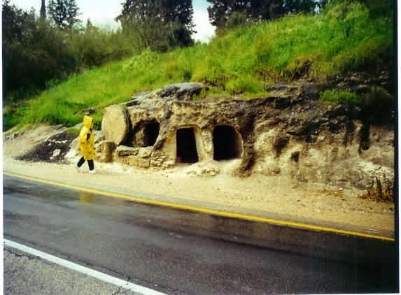
He is not Here!
Exclamavit Maria Magdalena, “Summi sacerdotes-ne et scribae hoc terribile faciebant?”
Vertit et cucurrit ad urbem Ierusalem ad Marci patris villam, ut Petrum et Ioannem inveniret et eis diceret corpus Iesūs captum esse.
Feminae in sepulchrum ingressae sunt, sed corpus Domini Iesūs non invenerunt. Magnopere confusae sunt. Duos homines stantes ibi gerentes fulgida vestimenta viderunt. Feminae territae sunt, itaque suas facies ad terram flexerunt.

Slide 21
He is not Here!
Homines eis dixerunt, “Nolite timere vos! Quaeritis Iesum, qui crucifixus est. Non est hic. Surrexit enim, sicut dixit. Venite et videte locum ubi positus erat Dominus. Memoriā tenete quid dixerit vobis, ‘Filius Hominis in manum peccatorum tradetur ut crucifigatur, et iterum surget’.” Feminae memoriā tenuerunt.
“Et celeriter ite; narrate Eius discipulis et Petro quod surrexit et in Galileam vos praecedit sicut dixit. Ibi Eum videbitis sicut vobis dixit.”
Et feminae celeriter exierunt, et e sepulchro fugerunt, tremebant enim et miratae sunt.

Slide 22
He is not Here!
Ioanna inquit, “Ego et Aquila ibimus ut discipulis in Bethaniā narremus quid viderimus et audiverimus. Ite, Maria et Salome, in Ierusalem et reliquis undecim discipulis narrate qui ad Marci patris villam manent.”
Sicut omnes feminae ex horto Ioseph discedebant, Virum ante se in viā subito viderunt.
“Salvete!” inquit. Vox erat tam familiaris. Itaque ad Eum properaverunt.
“Est Iesus, noster Dominus! A mortuis surrexit!” exclamavit Ioanna. Feminae in genibus ceciderunt et Eum adoraverunt.

Slide 23
He is not Here!
Brachia sua circum Eius crura posuerunt, et Eius pedes perforatos tetigerunt.
Feminis idem nuntium tunc dedit quod duo angeli eis dederant. “Nolite timere! Ite et mandate discipulis Meis ut veniant in Galileam. Ibi Me videbunt.”
Cum feminae iterum spectarent, Iesus ibi non erat.
Section B. English
He had disappeared. This caused them to worry even more. They must tell the disciples quickly. They bid each other a hasty farewell and rushed away, two going to Jerusalem and two rushing to Bethany.

Slide 24
He is not Here!
Joanna and Aquila were so excited that they ran most of the way back home. But before they reached the houses they met the disciples coming toward them as they were leaving Bethany. The two excited women stopped the disciples.
Aquila jubilantly told them, “The tomb was empty! There were two angels who told us that Jesus has arisen as He said He would!”
Joanna added excitedly, “The Master Himself stopped and talked to us on the road!”
The disciples were amazed. They shook their heads in dismay.

Slide 25
He is not Here!
“This cannot be! Your sorrow has overwhelmed you and has tricked your minds!”
“But we touched His feet and heard His voice!” cried Joanna.
Section C. Translate.
“Huic vere credere non possumus!”
Et discipuli misere discesserunt, ad Ierusalem lente ambulantes. Miraculum de eorum carissimo Domino surgente a mortuis erat difficilius pro eis.
Ioanna Aquilaque Bethaniam ambulabant. Erant miserae quoniam discipuli eis non crediderunt, sed suum gaudium continere non poterant.

Slide 26
He is not Here!
“Non erat somnium. Quattuor Eum vidimus et audivimus et tetigimus,” inquit Aquila.
“Nonne Eius pulchrum obtutum in nobis sensisti?” respondit Ioanna.
Ad Lazari villam statim ierunt. Sectatores a Bethaniā iam ibi convenerant, exspectantes feminas. Fidelius iterum ibi non erat quoniam ad castra cum suis militibus erat.
Cum feminae eis narrarent quid vidissent et quid audivissent, viri et feminae a Bethaniā crediderunt. Omnes gaudere incipiebant. Omnia verba quae Iesus eis docuerat vere intellecta sunt. Eorum carissimus Salvator, Deus Filius, in vacuo sepulchro non erat, a mortuis enim surrexerat sicut dixerat.

Slide 27
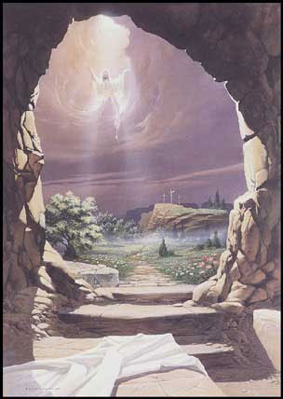
He really did rise from the dead!

