Slide 1
Chapter Twenty-seven
Hilarem enim datorem diligit Deus.

Slide 2
Contents
1
Impersonal Verbs
2
Periphrastics
3
The Supine
4
The Land of Galilee
5
The Book of James

Slide 3
Impersonal verbs have “it” as the subject.
licet = it is permitted
Licet tibi hoc audire. It is permitted for you to hear this.
or: You may hear this.

Slide 4
Another impersonal verb
Oportet Marcum domum venit.
oportet
It is necessary Marcus to come home.
Marcus must come home.

Slide 5
Yet another impersonal verb.
1.
Accidit
2.
It happened
3.
ut
4.
tu cucurrisses.
5. that you ran.

Slide 6
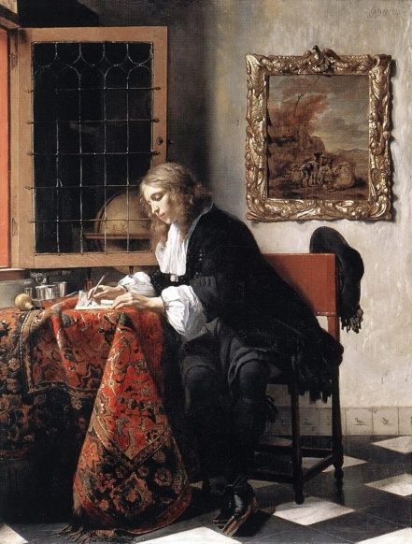
Passive Periphrastic
Gerundive with a form of sum
means “someone MUST do something.”
Epistula scribenda est.
A letter must be written.

Slide 7
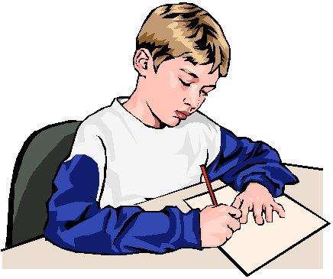
Dative of Agent
NOT Ablative of Agent.. But DATIVE with passive periphrastics.
Epistula tibi scribenda est.
A letter must be written by you.
You must write a letter.

Slide 8
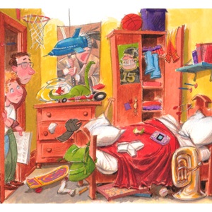
Tenses and Translations
PRESENT
Tuum cubiculum purgandum est.
Your room must be cleaned.
You must clean your room.
PAST
Tuum cubiculum purgandum erat.
Your room had to be cleaned. You had to clean your room.
FUTURE
Tuum cubiculum purgandum erit.
Your room will have to be cleaned.
You will have to clean your room.

Slide 9
Supine
The supine is the 4th principal part of a verb but with the neuter singular ending in accusative or ablative case.
With the accusative, it expresses purpose. Venit hic rogatum auxilium. He came here asking for help.

Slide 10
Supine
The supine witih the ablative case modifies the verb.
It looks like an infinitive in English.
Epistulae sunt iucundae scriptū.
Letters are fun to write.
YOU think of one!

Slide 11
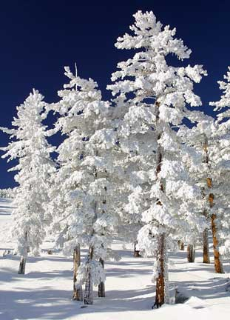
Vocabulary
agitatus exalto
confusus doleo
inusitatus interpello
nix licet
appareo oportet succedo

Slide 12
Exercise A.
Accidit ut fierent Christiani.
3/s. present or imperfect tense
It happened….
that….
they became Christians.

Slide 13
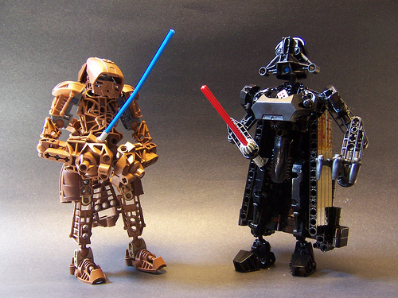
Exercise B.
1.
Oh that someone
would help
Utinam aliquis
adiuvet
the weak old man!
Infirmum senem virum!

Slide 14
Exercise C.
2.
Viri crura
The man’s knees
non fracti sunt.
were not broken.

Slide 15
Exercise D.
a. Oportet tibi haec facere.
It is necessary for you to do these things.
b. Haec tibi facienda sunt.
These things must be done by you.
Can they both be translated as:
You must do these things.

Slide 16
Exercise E.
1.
In which tense is the verb?
Milites imperatori ad Galliam mittendi sunt.
Present tense, passive periphrastic.
In which tense is the word imperatori?
Therefore, what is its function in the sentence?

Slide 17
The Land of Galilee
Regions of Galilee
Cities in Galilee
Climate in Galilee

Slide 18
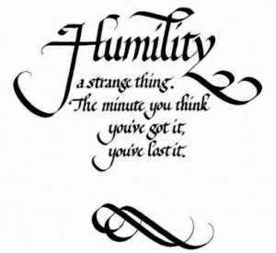
James 1:9-13
⁹Glorietur autem frater humilis in exaltatione sua,
¹⁰dives autem in humilitate sua, quoniam sicut flos campi, transibit.
¹¹Exortus est enim sol cum ardore, et arefecit foenum, et flos eius cecidit, et decor vultus eius deperiit. Itaque dives in itineribus suis marcescet.
¹²Beatus vir qui suffert temptationem, quoniam cum probatus fuerit, accipiet coronam vitae, quam promisit Deus diligentibus se.
¹³Nemo cum temptetur, dicat quod a Deo temptatur; Deus enim non temptatur malis. Ipse autem neminem temptat.

Slide 19
Questions about James
Should the lowly brother glory in his exaltation?
What may happen to the unrighteous rich man?
What is the reward for those who endure through temptation?
Does God tempt us to sin? Or could this mean that God tests us?

Slide 20
The Soldiers’ Story
Section A. Translate.
Section A. Ante primam lucem postero die (post Sabbata), tres milites ad Ioseph hortum quoque profecti sunt. Erant Centurio Romulus Fidelius et Quintus, qui erat Fideli legatus, et Centurio Longinus. Romanis militibus qui sepulchrum ubi Christi corpus positum erat servabant successuri erant. Nondum ad hortum appropinquaverant ubi prima lux diei apparebat.
Dum tres e Damasci Portā exibant, duo agitati custodes paene eos deiecerunt, sicut de viā ad Ierusalem currebant.

Slide 21
The Soldiers’ Story
Fidelius eis clamavit, “Salvete!”
Homines tremebant et erant albissimi. Tam agitati erant ut tres milites eos raperent et caperent ut prohiberent.
“Cur curritis? Cur a statione discessistis? Veniebamus ut vobis succederemus,” inquit Longinus.
“Sepulchrum est vacuum! Sepulchrum est vacuum!” utrique agitate clamaverunt.
Longinus, confusus, rogavit, “Quid dicitis?”
Fidelius interpellavit, “Nobis, homines, narrate quid acciderit. Scitis mortem futuram esse pro vobis si a statione vestrā discesseritis.”

Slide 22
The Soldiers’ Story
Fidelius et Longinus et Quintus duos custodes ad latus viae duxerunt ubi omnes sedere poterant. Tum duo quid factum esset narrare incipiebant, primum unus dicens et tunc alter. Hoc est quid dixerint:
“Ad hortum multo die Iudaeorum Sabbatorum venimus ut alteris duobus custodibus succederemus. Relaxabamus et parabamus ut laborem nostrum faceremus. Eā nocte non dormiebamus, sed loquebamur de rebus quae factae erant, praecipue de hac carnificinā.

Slide 23
The Soldiers’ Story
Plurimae carnificinae iniustae non sunt, sed haec nostros animos vere movit. Mane dum adhuc loquebamur, erat magna quassatio similis movendo terrae. Tunc angelus a caelo descendit, et vestimentum eius erat sicut nix. Movit saxum et super id sedit. Collapsi sumus similes mortuis. Cum stetimus, ita territi sumus a potestate angeli ut acurreremus. Nunc quid agere debeamus nescimus.”
Section B. English.
The three officers were overwhelmed. They knew what this meant. Jesus, their Christ, had risen from the dead!
Since these were Longinus’ men, he said to them, “Go back and report this to Pontius Pilate, and then you may go back to the barracks and rest.”

Slide 24
The Soldiers’ Story
The soldiers went back into town. The three officers turned to go to Bethany. Before they had gone very far, one of Fidelius’ men from the barracks came running after them. It was Linus, one of the soldiers who had come with Fidelius and Quintus from Capernaum and who was a follower of Jesus.
Linus said, “Sir, I thought you ought to know. The chief priests must have heard the story about the two sentries. Before the sentries could tell Pilate, the chief priests came into the barracks and took the two sentries away. They were telling the sentries not to tell Pilate what they had seen or heard.”

Slide 25
The Soldiers’ Story
They were telling the sentries not to tell Pilate what they had seen or heard.”
Answered Fidelius, “You did the right thing to come and tell us, Linus. Longinus, we must go back to the barracks. You know how treacherous the chief priests are. We may need to be on hand to give aid to your men.”
When they returned to the barracks, they had to wait a long time before the sentries returned. When they did return, they were laughing and happy. The three officers and Linus got them away from the other men in the barracks, so they could talk in private.
Longinus asked them, “What did the chief priests want with you?”

Slide 26
The Soldiers’ Story
“They wanted to hear our story about what happened in the Garden,” said the first sentry. “So we told them.”
“They were trembling with fear. Then they went off together to talk,” said the second sentry.
“When they came back, they told us not to tell anyone what really happened, but to say that the disciples came during the night and stole Jesus’ body while we were sleeping,” said the first sentry. “They gave us a great deal of money from the temple treasury, so we took it. We are supposed to tell their story instead of ours,” said the second.

Slide 27
The Soldiers’ Story
Section C. Translate.
“Fabulam sacerdotum tum narrabitis-ne?” rogavit Quintus.
“Narrabimus. Nulli nobis credent. Si vere dormiveramus, nostras vitas poenae trademus,” inquit primus.
“Summi sacerdotes dixerunt, ‘Si haec fama gubernatori data erit, ei dicemus et eum tranquillabimus. Nolite anxii esse! Nihil vobis accidet!’” inquit secundus. “Itaque eis credidimus.”
Sed multi qui sacerdotum fabulam audiverunt quaestiones non rogaverunt, et fabula de discipulis inter homines longe et late volavit. Multi Iudaei discipulos cepisse corpus Iesūs crediderunt et id celavisse.

Slide 28
The Soldiers’ Story
Sed Fidelius et Quintus et Longinus famae crediderunt de Iesu surgente a mortuis. Properaverunt ad Bethaniam ut omnibus narrarent, “Sepulchrum est vacuum! Iesus a mortuis surrexit sicut dixit!”
Primum summi sacerdotes Iesum surrexisse a mortuis crediderunt. Tremebant magno timore, sed a peccatis non verterunt. Cum undecim discipuli famam de Iesu surgente a mortuis audirent, ei non crediderunt, etsi Iesus eis praedixerat.

Slide 29
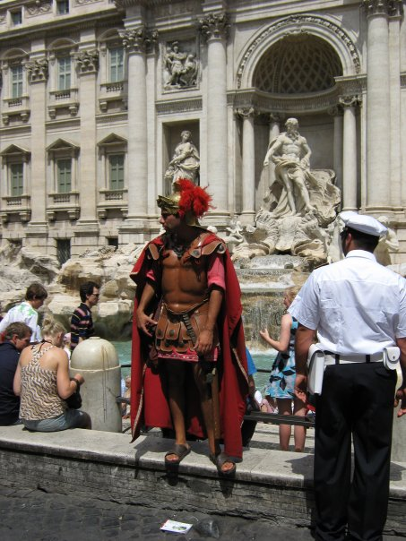
A Roman Soldier

