Slide 1
Chapter Twenty-five
Verbum autem Domini manet in aeternum, hoc est autem verbum quod evangelizatum est ad vos.

Slide 2
Contents
Latin verbs followed by the Dative Case
credo
impero
mando
permitto
servio

Slide 3
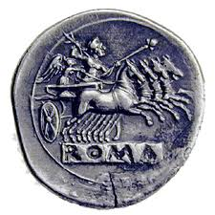
Dative of Possession
De + sum = is lacking.
Pecunia viro deest.
Money is lacking to the man.
Reword the sentence. The man doesn’t have any money.
YOU think of a sentence!

Slide 4
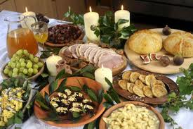
Vocabulary
postquam continuo
culpa desum
ientaculum placeo
officina provideo
plebs resisto
condemno studeo
consulo

Slide 5
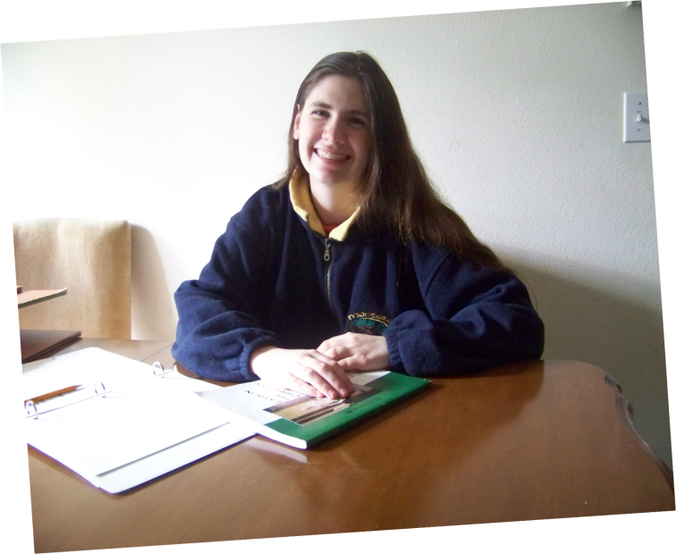
Exercise A.
Scientiae student
Is the verb one of those which is followed by the dative?
Scientiae = nom. pl. or gen. sg., or dative sg.?
It doesn’t make sense to say “the knowledges study.”
student = a verb, 3/pl.
She is eager for knowledge.

Slide 6
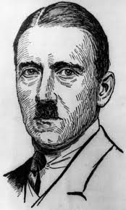
Exercise B.
We do not trust evil men.
We do not give our trust to evil men.
Malis non credimus.
Exception:
Some authors say:
Malos non credimus.

Slide 7
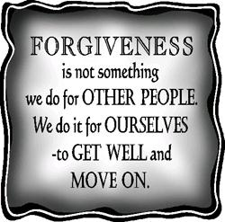
Exercise C.
Si Deum peccata vestra dimittere vis, alios dimittere debes.
First clause:
If you wish God to forgive your sins,
Second clause:
you ought to forgive others.

Slide 8
James I
¹ Iacobus, Dei et Domini nostri Iesus Christi servus, duodecim tribubus, quae in dispersione, salutem.
² Omne gaudium existimate, fratres mei, cum in tentationes varias indiceritis.
³ Scientes quod probatio fidei vestrae patientiam operatur.
⁴ Patientia autem opus perfectum habet; ut sitis perfecti et integri in nullo deficientes.

Slide 9
James 1
5 Si quis autem vestrum indiget sapientia, postulet a Deo, qui dat omnibus affluenter, et non improperat, et dabitur ei.
6 Postulet autem in fide nihil haesitans, qui enim haesitat, similis est fluctui maris, qui a vento movetur et circumfertur.
7 Non ergo aestimet homo ille quod accipiat aliquid a Domino.
8 Vir duplex animo inconstans est in omnibus viis suis.

Slide 10
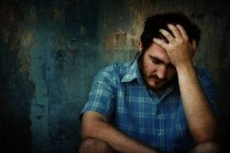
Questions
1. Did James write this epistle to the Christians or to the non-believers?
2. What is his thought about suffering trials?

Slide 11
Questions.
3. How can we obtain wisdom?
4. What happens to a person who doubts all the time?

Slide 12
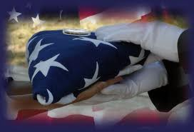
Gen. Douglas MacArthur
Memorize this quote and discuss its meaning.
“The measure of a nation′s greatness is how it treats its dead.”

Slide 13
The First Sabbath
Section A. Sabbatis mane erat post mortem Iesūs. Fidelius et Quintus et Longinus ad castra redierant. Dormire temptaverant, sed Longinus de Iesu rogabat, itaque tandem surrexerunt. Ientaculum ederunt et sederunt ut loquerentur. Fidelius et Quintus Longino omnia quae sciverunt de Iesu narrare inceperunt.
Mox Tribunus Marcellus in castra venit. Dixit tribus hominibus, “Alius nuntius a Pilato ad me missus est. Summi sacerdotes dixerunt, ‘Putamus Iesūs discipulos corpus Iesūs capturos esse ut dicant plebi Eum a mortuis surrexisse’.

Slide 14
The First Sabbath
Itaque Pilatus nos iussit ante ianuam sepulchri Romanum signum ponere, et tunc duos milites praesidio circum hortum ponere.
Volo vos tres homines deligere duos alios homines et ire et praesidio stare. Cum saxum ante ianuam posueritis, imperate aliis duobus militibus ut praesidio maneant. Tunc tres discedatis. Scio, Fideli, te velle ire domum ad familiam tuam.

Slide 15
The First Sabbath
Quoniam sunt Sabbata, Iudaei in domibus erunt, itaque erit solum parvus labor quem facere poterimus hic. In meā officinā hodie manebo.”
Tres homines ei serviebant. Postquam signum ante ianuam sepulchri ponebatur, Fidelius aliis duobus militibus narravit, “Servate sepulchrum dum duo alii milites venerint. Tum discedatis.”
Tum Fidelius Quintum Longinumque rogavit, “Quoniam est nullum opus pro nobis, meam domum venire voletis-ne, ut de Iesu dicere continuemus? Mea familia et amici in Bethaniā plura dicere poterunt quam ego.”

Slide 16
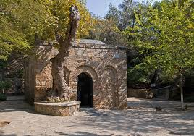
The First Sabbath
Itaque Quintus et Longinus, loquentes continenter, domum cum Fidelio ambulaverunt. Cum appropinquavissent ad Fideli villam in Bethaniā, nulli e familiā ibi erant. Solus Ioannes, servus Fideli, ibi erat.
“Omnes, Domine, ad Lazari villam sunt. Nulli bene inter priorem noctem dormire poterant, itaque ibi ibant ut de Iesu loquerentur. Domi manebam ut meum laborem conficerem,” Ioannes dixit.

Slide 17
The First Sabbath
“Si confecisti, nobiscum ad Lazari villam veni,” inquit Fidelius.
Itaque quattuor homines ibant ad alteram villam et omnes a Bethaniā qui erant discipuli Iesūs inveniebant. Nonnulli discipuli ex undecim venerant, quoniam se esse salviores in Bethaniā longe a summis sacerdotibus senserunt. Maria Magdalena et Maria uxor Cleophae et Salome uxor Zebedaei ibi erant etiam. Ad Bethaniam cum Ioannā et Aquilā et Mariā et Marthā e sepulchro venerant. Fidelius complexum suae familiae iterum dedit.

Slide 18
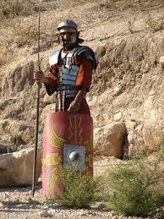
The First Sabbath
Tum dixit, “Hic est meus amicus, Longinus.” Mirati sunt, quoniam sciverunt Longinum fuisse militem qui Iesum crucifixerat.
Fidelius rogavit, “Narrabis-ne, Longine, omnibus de veniendo tuo ad Dominum?” Omnes anhelaverunt!

Slide 19
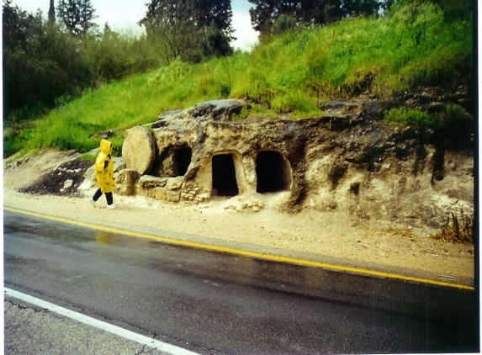
The First Sabbath
Section B. English
Longinus began telling his story. When he had finished, he said, “I want to know everything about Jesus. Fidelius has been telling me many of the things he has seen and heard.”
“We have each been telling what we have seen and heard these last two days. It has helped to keep us from grieving so much,” said Lazarus. “Since today is the Sabbath, we cannot go and visit the grave, but we will be going tomorrow.

Slide 20
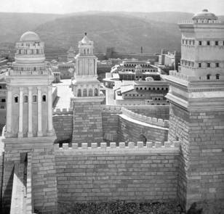
The First Sabbath
Before you came in, Chuza was telling us what had
happened when he went to Herod’s palace.” “I arrived there too late. Jesus had been there and was gone,” said Chuza. “But I did talk to Herod’s Cupbearer, and he told me what had happened. This is the Cupbearer’s story:
‘When Jesus was standing before Pilate, Pilate realized that Jesus belonged under Herod’s jurisdiction, so he sent Him to Herod at the Palace Hippicus in Jerusalem.

Slide 21
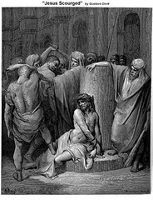
The First Sabbath
When Herod saw Jesus, he was extremely glad, because he had wanted to see Him for a long time. He had heard many things about Jesus, and he hoped to see some miracle done by Him. Then Herod questioned Him intensely, but Jesus answered nothing. The chief priests and scribes stood and vehemently accused Him. Herod, treating Him with contempt, ordered his palace guards to hit Jesus in the face and mock Him, saying, “So You are the King of the Jews!”

Slide 22
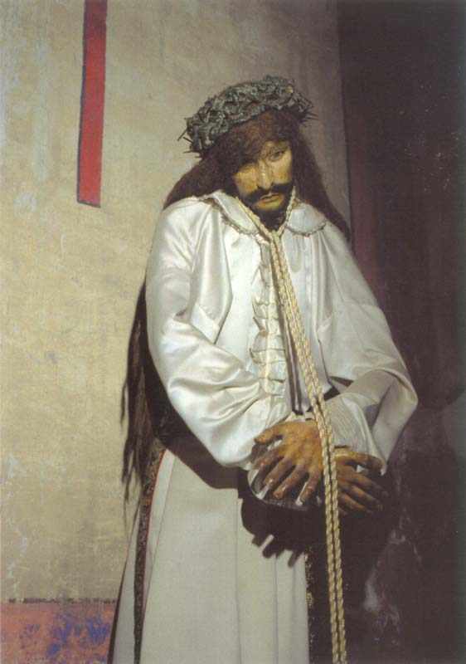
The First Sabbath
Then they covered Him with a gorgeous robe and sent Him back to Pilate. And on that day Pilate and Herod became friends: before then there was emnity between them.’
Section C. Tum Longinus dixit, “Stationem non agebam eo die, itaque in castris eram ubi Iesus ad Pilatum relatus est.

Slide 23
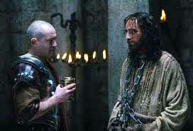
The First Sabbath
Postquam Iesus condemnabatur, ad stationem positus sum. Imperavit mihi et meis militibus ut Iesum crucifigeremus. Etiam audivi quid factum esset ab uno ex meis hominibus qui erat ibi. Quod dicebat eo tempore me non vexabat, sed nunc me vexat. Dixit haec:

Slide 24
The First Sabbath
‘Pilatus Iesum rogavit, “Tu es Rex-ne Iudaeorum?”
‘Respondens, Ille ei dixit, “Tu dicis.”
‘Et cum accusaretur a principibus sacerdotibus et senioribus,
nihil respondit.
‘Tum dixit Illi Pilatus, “Nonne audis quanta contra Te dicant testimonia?”
‘Sed Iesus non respondit.
‘Pilatus iterum ibat ad Iudaeos et illis dixit, “In Eo nullam culpam invenio. Sed mos est vobis ut unum dimittam vobis in Paschā; vultis-ne ergo dimittam vobis Regem Iudaeorum?”

Slide 25
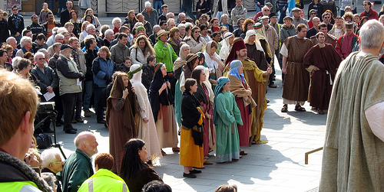
The First Sabbath
‘Tum summi sacerdotes et seniores multitudini persuaserunt ut rogarent ut Barabbas dimitteretur. Clamaverunt ergo iterum omnes, dicentes, “Non hunc, sed Barabbam.” Erat autem Barabbas fur.
‘Pilatus autem iterum respondens dixit illis, “Quid ergo vultis faciam Regi Iudaeorum?”
‘Clamabant iterum, “Crucifige Eum!”
‘Pilatus vere illis dixit, “Quid enim mali fecit?”
‘Illi iterum clamabant, “Crucifige Eum!”

Slide 26
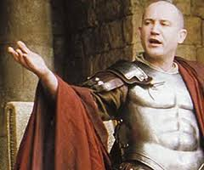
The First Sabbath
‘Itaque Pilatus, volens populo satisfacere¹, dimisit illis Barabbam, et tradidit Iesum ut flagellis vapularet et crucifigeretur. Pilati milites in atrium quod appellabatur Praetorium Eum duxerunt.
Milites tradiderunt Iesum meis copiis ut Eum pararent ut crucifigeretur.’
“Hoc tempore vocatus sum,” inquit Longinus. “Ad Praetorium veni.

Slide 27
The First Sabbath
Cum appropinquarem, milites Eum purpureis vestimentis induerant, et imposuerant super caput Eius spineam coronam. Nonnulli genua flexerunt sicut Eum adorabant. Alii Eum salutabant, dicentes, ‘Salve, Rex Iudaeorum!’ Postquam riserant Ei, abdiderunt ex Eo vestimenta purpurea et induerunt in Eum vestimenta Sua ut crucifigerent Eum. “Hoc tempore mandata educere accepi Eum ut crucifigeretur.
“Dum ad Golgotha ibamus, Iesus, qui male flagellatus erat, cadere incipiebat, quoniam erat infirmissimus.
Eius crux erat gravissima.

Slide 28
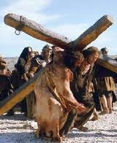
The First Sabbath
Cyrenaeum nomine Simonem, qui prope ambulabat, coegi ut ferret crucem Eius. Reliquam fabulam omnes scitis.”
Fabulā confectā, servi cenam tulerunt. Lazarus orabat. Dum edebant, alius ex alio aliquid narrabat quod memoriā tenebat et quod de Iesu audiverat vel viderat.

Slide 29
Everyone leaves for home.
Postquam omnes ederant et vasa purgaverant, Lazarus inquit, “Eamus omnes nostras domos ut requiescamus, si cras ire speramus ut sepulchrum visitemus.”
Omnes dixerunt “Valete!” et in varias partes ierunt. Viri feminaeque domos suas in Bethaniā iverunt. Maria Cleophae et Salome cum familiā Lazari manebant, et Maria Magdalena cum familiā Chuzae manebat. Longinus et Quintus ad castra donec cras redibant.

Slide 30
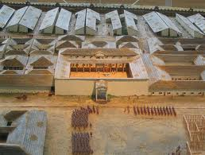
Fidelius’ Camp

