Slide 1
Chapter Twenty-four
Nolite conformari huic saeculo, sed reformamini in novitate sensūs vestri.

Slide 2
Contents
Fero
Relative Clauses of Purpose
Crucifixion
He is Dead and in the Tomb

Slide 3
A Root Word
Many Latin and English words are formed from the word fero.
fero, ferre, tuli, latus
Pronounce like this: FAIR oh.. FAIR ray.. TOO lee.. LAH toos
Present Tense
fero ferimus fers fertis
fert ferunt

Slide 4
Purpose Clause using ut or ne.
You have already learned that purpose clauses can be formed using ut or ne.
He came home to eat dinner.
Domum venit ut cenam ederet.

Slide 5
Relative Clauses of Purpose
A slight difference…
He came home so we may eat dinner.
He came home who might eat dinner.
Domum venit qui cenam ederet.

Slide 6
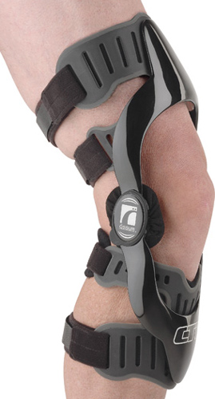
Vocabulary
crus confer
genu fero
poena incendo
sanguis infero
sepulchrum obtineo
adfero refero
claudo tollo

Slide 7
Exercise A.
What is a synopsis?
All six tenses, both active and passive voices of the verb in the same person and number.

Slide 8
Exercise B.
Fer ad Dominum difficultatem.
Fer = imperative singular
difficultatem = accusative singular
ad Dominum = prepositional phrase
Bring (your) difficulty to the Lord.

Slide 9
Exercise C.
Cur tantum periculum ad nostram terram fers?
Cur = adverb tantum periculum = accusative singular
ad nostram terram = accusative of place to which
fers = 2nd person singular present active
Why do you carry such a great danger to our land?

Slide 10
Crucifixion!
Literally it means “affixed to a cross.”
What causes death in a crucifixion?

Slide 11
Reading Lesson
Section A. Translate.
Quot minutas in terrā iacuisset nesciebat ubi magnas voces audivit. Ubi Iesūs crucem spectabat, omnes feminas lacrimantes miserrime vidit. Mariam, matrem Iesūs, et adulescentem, discipulum nomine Ioannem, qui prope eam stabat, vidit. Totus globus a Marci patris villā venerat. Viri circum Fidelium convenerunt. Sciverunt eum non habere auctoritatem in quā hoc malum prohiberet.

Slide 12
Quintus tries to stop it.
Quintus ad Fidelium ambulavit et dixit, “Miser sum, sed prohibere hoc non poteram.”
“Scio, Quinte. Intellego te fecisse optimum tuum,” respondit Fidelius.
Tum omnes in terrā ad genua procumbere incipiebant, et ad crucem Domini sui spectabant. Quid accideret proximum mirati sunt.
Tunc audiverunt Iesum ubi dicebat, “Pater, dimitte illos; non enim sciunt quid faciant.”
Nonnulli sacerdotes ad collem ascendebant, et Iesui irridere incipiebant, dicentes, “Alios salvos fecit; Se salvum facere non potest.

Slide 13
Priests mock Jesus.
Christus Rex Israel iam de cruce descendat ut videamus et credamus!”
Unus e duobus furibus qui crucifixi sunt cum Eo blasphemare incepit Eum, dicens, “Si Tu es Christus, salvum fac Se et nos.”
Respondens autem alter increpabat eum, dicens, “Num tu times Deum etsi condemnaris? Et nos vere, iuste, nam poenam factis nostris accipimus. Hic vere nihil mali fecit.”
Et dicebat ad Iesum, “Domine, memento mei cum veneris in regnum Tuum.” Et dixit illi Iesus, “Amen, dico tibi, ‘Hodie Mecum eris in paradiso’.”

Slide 14
Crucifixion

Slide 15
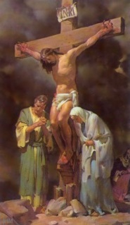
Jesus blesses John and His mother.
Cum vidisset ergo Iesus matrem Suam, et discipulum quem diligebat ibi stantem, dixit matri Suae, “Femina, ecce filius tuus.”
Deinde dixit discipulo, “Ecce, mater tua.” Et ex illā horā accepit eam discipulus in suam domum.

Slide 16
Section B. English
Then came the sixth hour. There was darkness over the whole earth. The darkness covered the sun, moon, and stars; therefore, there was no light in the darkness. This strange darkness terrified everyone and made them feel very small and vulnerable. So everyone sat down right where they were, huddled together. God the Father and God the Holy Spirit had supernaturally covered Jesus, God the Son, in darkness, so unrighteous man could not see God the Son bearing all the sin of the whole world. This lasted for three hours.

Slide 17
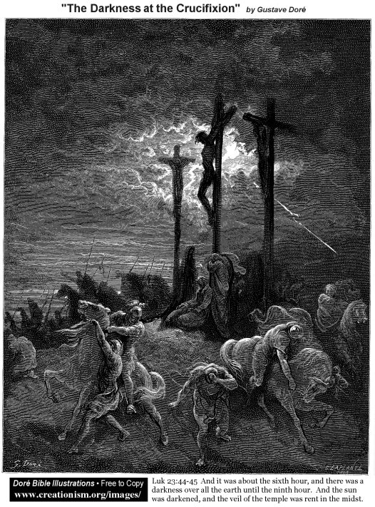
Darkness

Slide 18
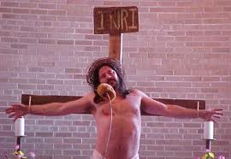
Reading Lesson
At the ninth hour there was a mighty earthquake. Then Jesus cried out with a loud voice, “Eli (God the Father), Eli (God the Holy Spirit), lama sabachthani (Why have You forsaken Me?)”
One of the soldiers standing nearby cried, “Behold, he is calling for Elijah!” It was Longinus Centurion Posterior. Then he
ran and filled a sponge with vinegar,
and put it upon a hyssop stem and
put it to Jesus′ mouth.

Slide 19
Reading Lesson
When Jesus received the vinegar, He said, “It is finished! Father, into Your hands, I commend my spirit.” Jesus bowed His head and gave up the spirit. At that time there was another earthquake.
When things got quiet, Fidelius and Quintus came to the foot of the cross. Longinus came up to them, and threw his arms around their shoulders, weeping. “Truly He was the Son of God!” Fidelius and Quintus in their sorrow rejoiced over their fellow soldier-in-arms.

Slide 20
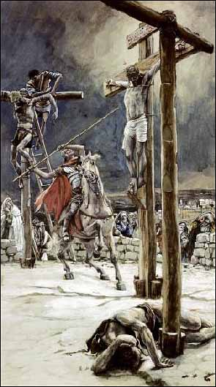
Reading Lesson
About that time a soldier
came to them with a message
from Pilate to Longinus.
Longinus read the message,
then he said, “The priests of
the Jews have gone to Pilate
asking that the bodies not
remain after sunset. We are to
take them down, break their bones, and haul them away.”

Slide 21
Reading Lesson
At the ninth hour there was a mighty earthquake. Then Jesus cried out with a loud voice, “Eli, Eli, lama sabachthani.”
One of the soldiers standing nearby cried, “Behold, He is calling for Elijah!” It was Longinus Centurion Posterior. Then he ran and filled a sponge with vinegar, put it upon a hyssop stem, and put it to Jesus’ mouth.
When Jesus received the vinegar, He said, “It is finished! Father, into Your hands I commend my spirit.” Jesus bowed His head and gave up the spirit. At that time there was another earthquake.

Slide 22
Reading Lesson
When things got quiet, Fidelius and Quintus came to the foot of the cross. Longinus came up to them and threw his arms around their shoulders, weeping. “Truly He was the Son of God!” Fidelius and Quintus in their sorrow rejoiced over their fellow soldier-in-arms.
About that time a soldier came to them with a message from Pilate to Longinus. Longinus read the message; then he said, “The priests of the Jews have gone to Pilate asking that the bodies not remain after sunset. We are to break their bones, take them down, and haul them away.”

Slide 23
Reading Lesson
Section C. Milites venerunt et crura primi fregerunt, et tunc alterius, qui crucifixi sunt cum Eo. Ad Iesum autem cum venissent, quoniam viderunt Eum esse iam mortuum, non fregerunt Eius crura. Unus autem militum lanceā latus Eius aperuit, et exivit sanguis et aqua.
Adulescens nomine Ioannes qui stabat prope dixit, “Facta sunt enim haec ut Scriptura impleretur, ‘Os non comminuetis ex Eius corpore’. Et iterum alia Scriptura dicit, ‘Videbunt in Eum quem transfixerunt’.” Ioseph et Nicodemus, ferentes lintea cum aromatibus, ad collem ascendebant.

Slide 24
Joseph’s Tomb
Etiam nuntium, quod eis permissionem dedit ut Iesūs corpus ad sepulchrum moverent, a Pilato tulerunt. Acceperunt corpus Iesūs, et ligaverunt linteis cum aromatibus.
Nunc in eo loco ubi Iesus crucifixus erat, erat hortus; et in horto erat monumentum novum in quo nemo ante positus erat quoniam monumentum erat Ioseph. Fidelius et Quintus adiuverunt Ioseph et Nicodemus dum ibi Iesum tulerunt, et in monumentum novum Eum posuerunt. Feminae secutae sunt, portantes lintea cum aromatibus.
Longinus tum in hortum cum aliis militibus venit. Milites saxum ante ianuam sepulchri posuerunt.

Slide 25
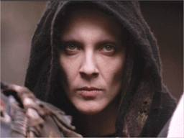
Reading Lesson
Tum omnes discedere incipiebant. Sabbata appropinquabant, et erat contra legem manere ad locum mortis Sabbatis.
Fidelius et Quintus et Longinus et sui milites ad castra redierunt. Fidelius eis complexum dedit, et “Valete!” dixit. Stans post eos erat Iesus, qui portas inferni clauserat pro omnibus.

Slide 26
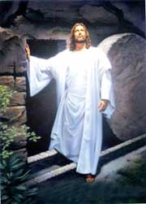
He will rise again!
Nondum id sciebant, sed mox id bene intellegent. Sed nunc parva manus virorum feminarumque umbras mortis cecidisse super eos sensit. Adhuc tamen Unum qui erat Dominus suus et Magister dilexerunt, et fortior quam mors erat sua caritas.

Slide 27
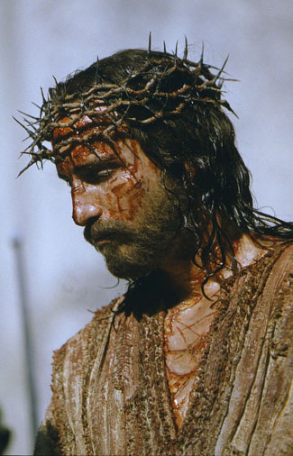
Passion of the Christ
Assignment:
Watch the
movie produced
by Mel Gibson.

